Slide 1

AIR QUALITY PREDICTION AND DETECTION USING MACHINE LEARNING
SET CONFERENCE
First Review
22MCA0209 - HRIDAM CHAKRABORTY
22MCA0265 - BHUBESH SR
22MCA0273 - RITESH GUPTA
Guide Name: Dr. RAMALINGAM M

Slide 2
01
ABSTRACT

Slide 3
ABSTRACT
Air quality Plays a vital role in human Health. Pollution in Air leads to a vast number of health issues. It is a vast problem in major metropolitan cities where the population density is high.
Air pollution caused by various parameters taken by people, such as transportation, power, and fuel use, are affecting air quality. Monitoring, predicting, and detecting air quality have become essentially important in this era, mainly in developing countries like India. Air Quality Index (AQI), is used to measure the quality of air.
Machine learning (ML) is a field in which an artificial intelligence device collects sensor data and learns to act. Machine Learning (ML) is the better approach to predict air quality as compared to other techniques such as probability and statistical methods. Predict air relative humidity by considering various parameters such as CO, Benzene, Titanium, NO, Sulfur dioxide, etc.

Slide 4
02
PROPOSED WORK

Slide 5
Proposed Work
The information of Air pollution is collected using some sensors and some others from satellites that get processed and stored in a dataset. After collection of the dataset , it gets preprocessed using some methods such as Normalization , Discretization and Attribute selection.
If the Dataset is ready , the dataset is split into training and testing dataset. Supervised Machine Learning Algorithms are applied on the training dataset to get the appropriate results.
The results are matched with the testing dataset and results are analyzed.The Air pollution prediction uses several supervised machine learning algorithms considers Autoregression , Linear Regression , Decision tree , Support Vector Machine.

Slide 6
03
ALGORITHMS USED

Slide 7

Linear Regression(LR)
The supervised learning algorithm is used to find linear relationships between target (independent variable ) and predictors(dependent variable).
Linear Regression gives a sloped line of straight which describes the relationships within the variables. In case the Value of x i.e independent variable increases , the y axis i.e dependent variable also increases , directly proportional to each other.

Slide 8
Random Forest(RF)
The implementation of the RF model is using the Scikit-learn random forest classifier class.
This meta estimator fits several decision tree classifiers on various sub-samples of the dataset.
multiple hyperparameters that have been altered to achieve optimal results. The remaining parameters are as default

Slide 9
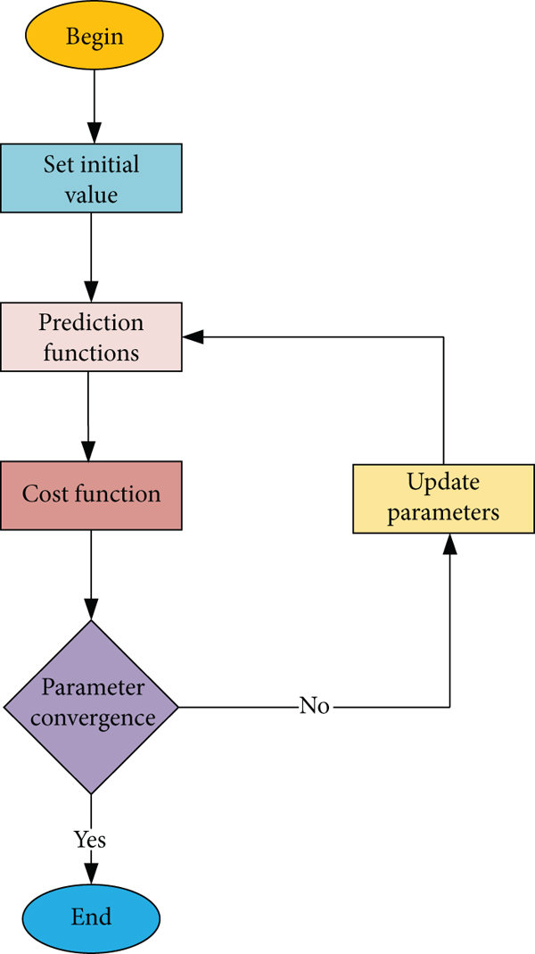
Flowchart for RF

Slide 10
04
DETAILED DESIGN

Slide 11
System Architecture
Predicting air quality is important to industry and pollution management. The second stage of data pre-processing Whatever data we have is raw, and if we apply it to a model straight, the output could be incorrect.
Preprocessing is an important stage in data forecasting. When the values are too large for the model to understand, a transformation step is required.

Slide 12
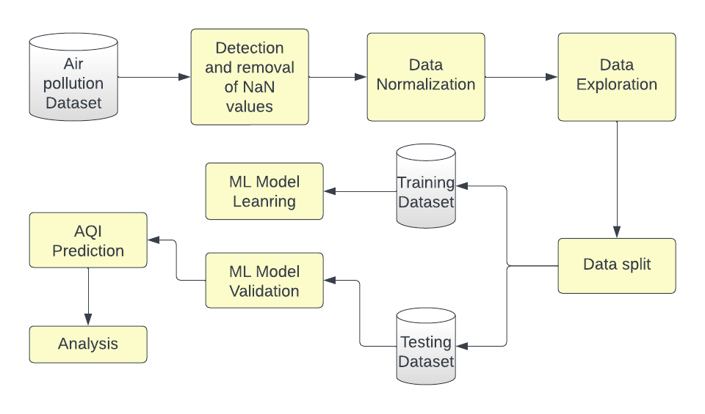
System Architecture

Slide 13
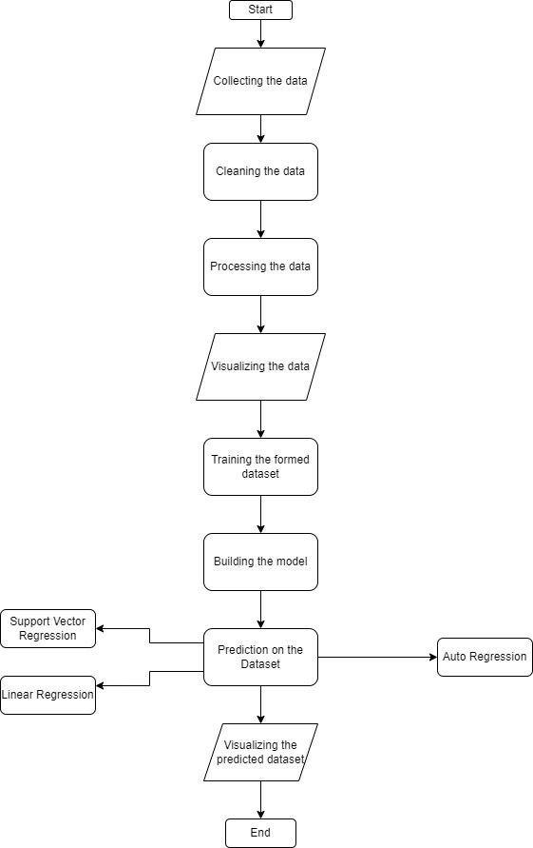
Data Flow

Slide 14
05
IMPLEMENTATION

Slide 15
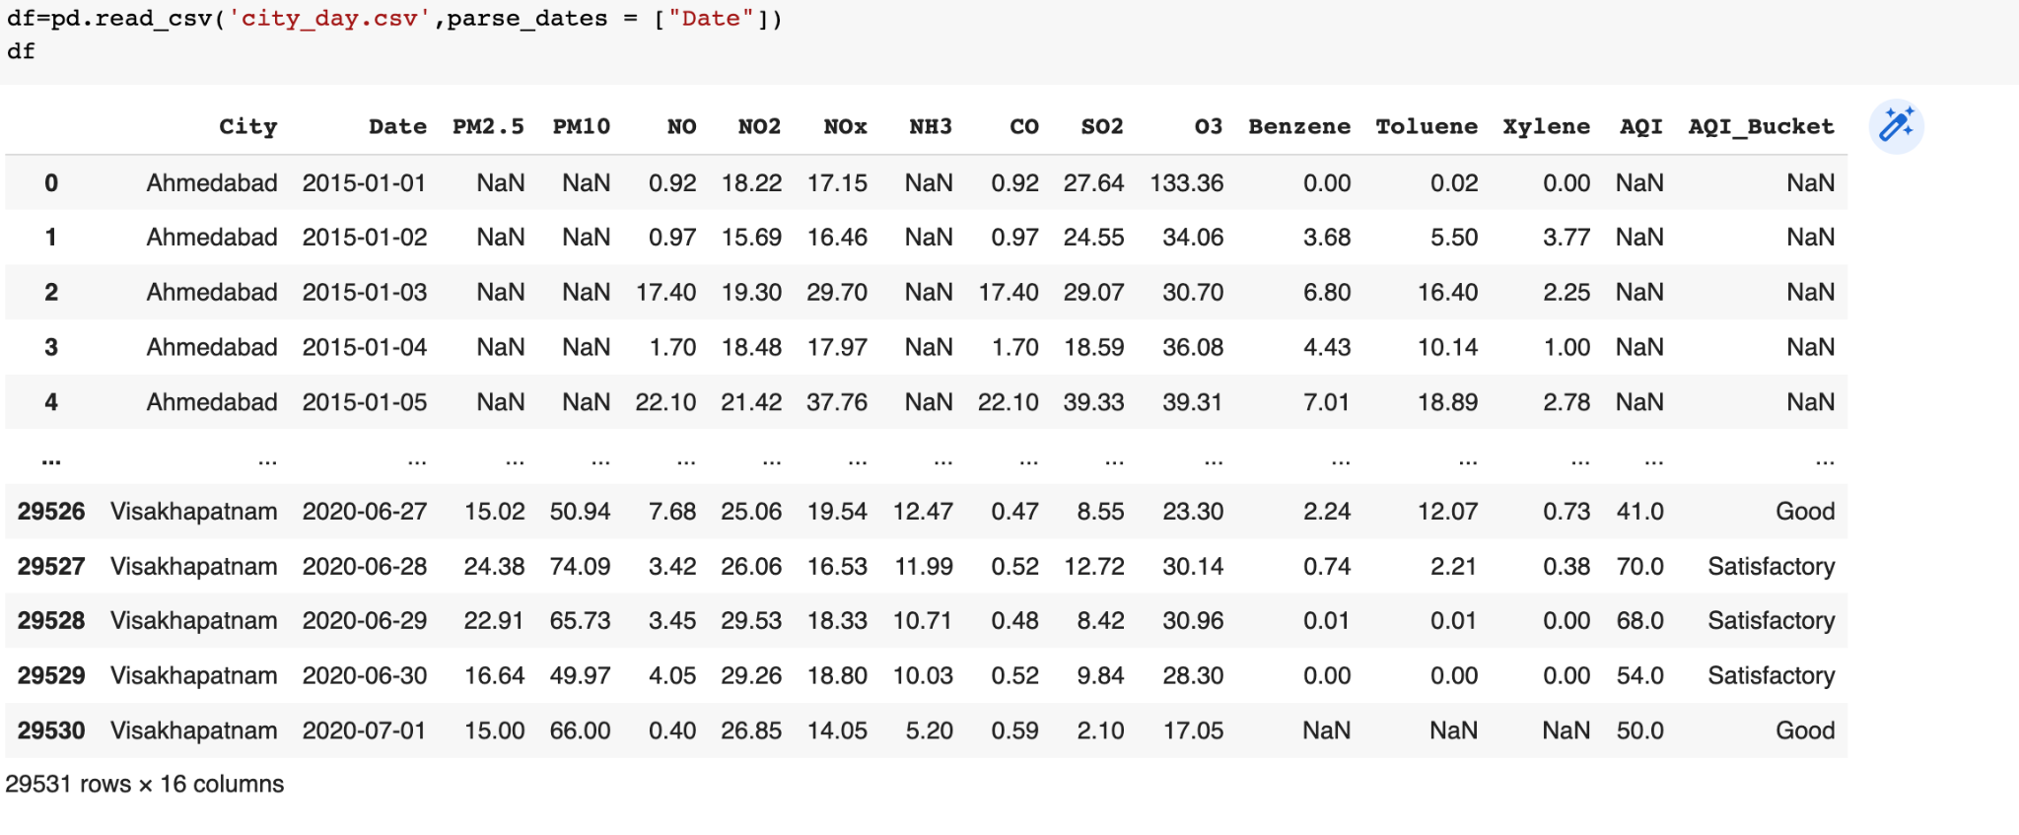
Dataset

Slide 16
Data Preprocessing
Data preprocessing in Machine Learning is a crucial step that helps enhance the quality of data to promote the extraction of meaningful insights from the data.
Data preprocessing in Machine Learning refers to the technique of preparing (cleaning and organizing) the raw data to make it suitable for a building and training Machine Learning models.
Data preprocessing in Machine Learning is a data mining technique that transforms raw data into an understandable and readable format.

Slide 17
Steps in Data Preprocessing
1
5
Acquire the dataset
Encoding the categorical data
2
6
Import all the crucial libraries
Splitting the dataset
3
Import the dataset
7
Feature scaling
4
Identifying and handling the missing values

Slide 18
Imputation Of Missing Data
We found that more than 30 -40% data was missing, so we removed the SPM field from the Central Pollution Control Board data.
For the other fields in the US embassy data and the Central Pollution Control Board data, we substituted missing data by second order polynomial estimation using nearest available data points. It gave better results than using series mean or linear interpolation.

Slide 19
Removing or Modifying Outliers
An irregular pattern was observed in pollutant data between August and October 2020 in both US embassy data and the Central Pollution Control Board data.
Thus, these data were removed. For data modification, we used the power transformation method.
This provides a nonlinear transformation that is more robust to noise and hence produces better data.

Slide 20
Feature Extraction
The date component in the Central Pollution Control Board data and the date-time component in the US embassy data were used to produce new features.
The cyclic nature of the time component was exploited to obtain two fields {sin(2πhour/24), cos(2πhour/24)}. The date component was also used to obtained fields for day, month and year

Slide 21
Feature Selection
From the features obtained in the previous step using feature engineering, a few variables were selected to reduce dimensionality of the dataset and remove collinearity. Correlation-based feature selection was used , to check for collinearity among features. It was observed that the concentration of some of the pollutants had an almost linear correlation.
We also used Principal Component Analysis (PCA) for reducing the dimensionality of the dataset. It enabled us to reduce the
number of variables for each pollutant by about 76%. We compare the results with and without PCA in the next section.

Slide 22
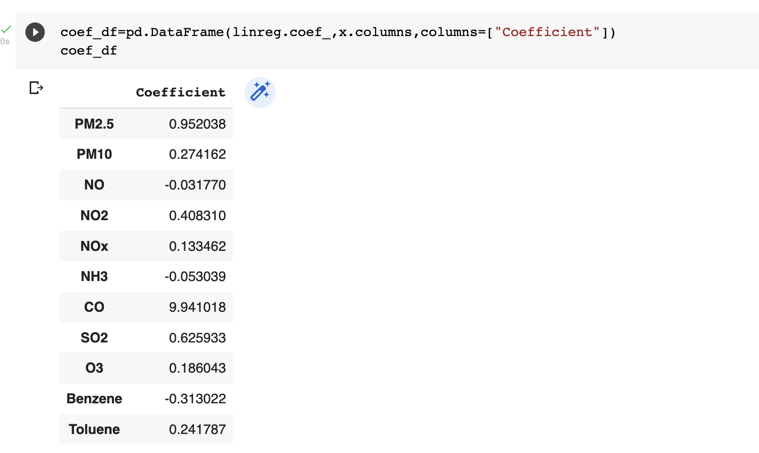
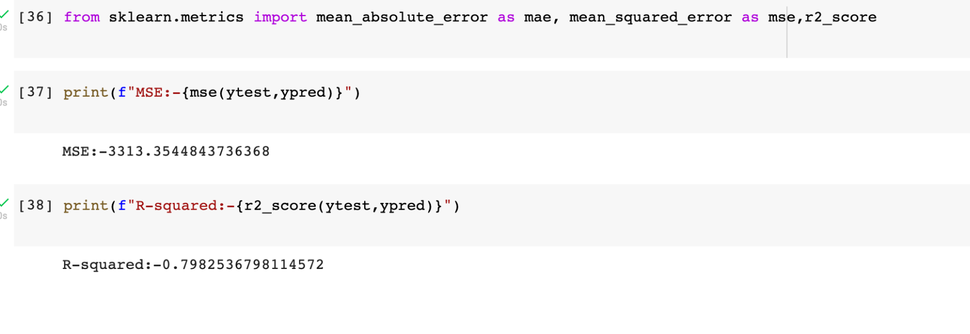
Linear Regression
Coefficient of Linear Regression
Accuracy is Found 80% from RMSE

Slide 23
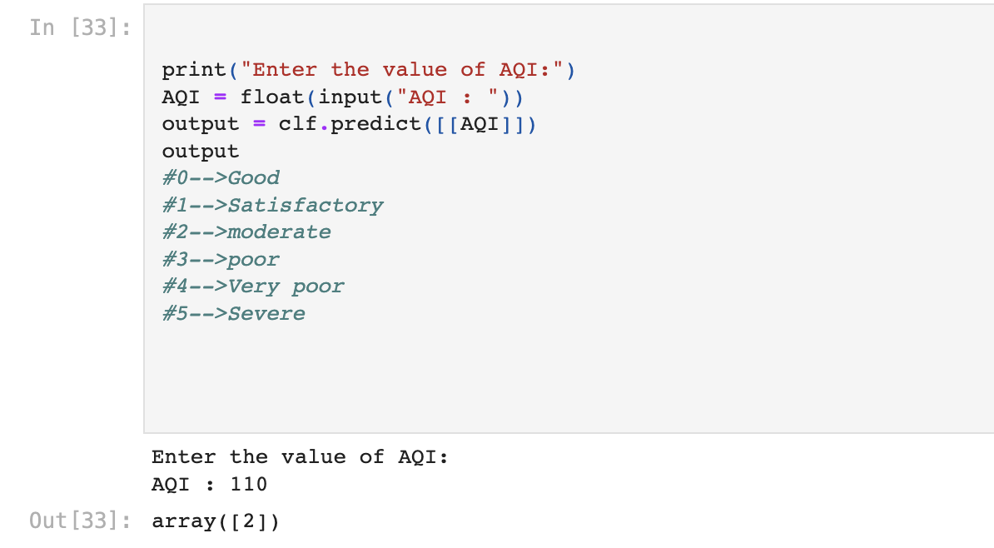
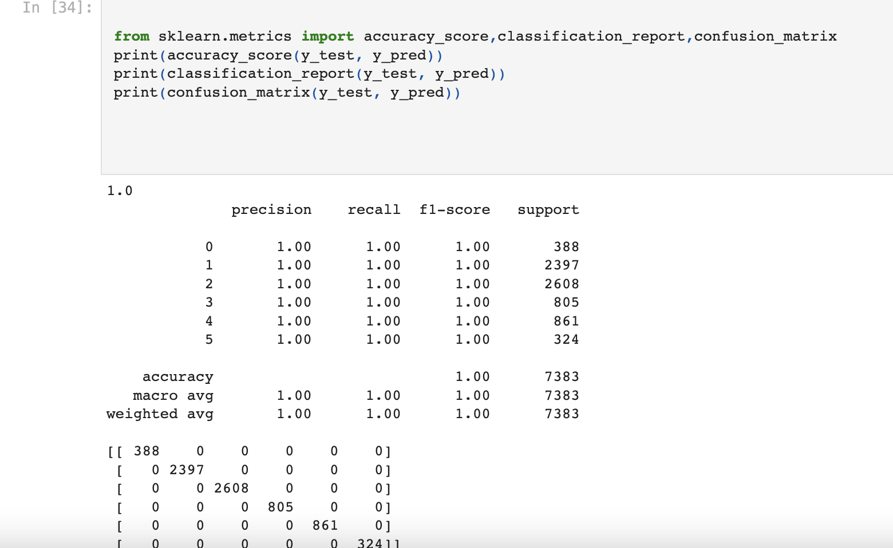
Random Forest
AQI PREDICTION

Slide 24
Thank you!

